Slide 1
M. Tech (CSE) – Second Semester (Term: July-October 2022) Non CIE component on
Bell inequalities and entanglement
Department of Computer Science and Engineering
Faculty:
Dr Rajarajeswari S
Presented By:
Pranamya Kashyap MP

Slide 2
EPR paradox
In 1935, Albert Einstein, Boris Podolsky, and Nathan Rosen wrote a paper entitled “Can quantum mechanical description of physical reality be considered complete?”
The experiment involves a pair of photons in the state 1 / √ 2 (|00>+|11>).
Pairs of particles in such a state are called EPR pairs
EPR pairs are maximally entangled i.e for example Imagine a source that generates EPR pairs
1/ √ 2 (|00>+|11>) and sends the first particle to Alice and the second to Bob.
Alice and Bob can be arbitrarily far apart.
Each person can perform measurements only on the particle he or she receives.

Slide 3
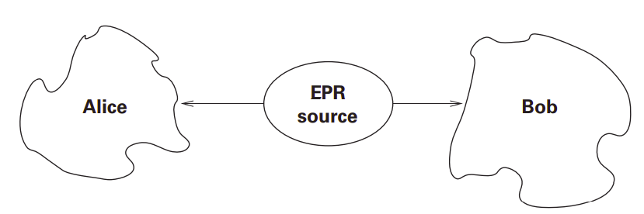
EPR paradox
if Alice measures her particle in the standard single-qubit basis, and observes the state |0>, the effect of this measurement is to project the state of the quantum system onto that part of the state compatible with the results of Alice’s measurement, so the combined state will now be |00>.
If Bob now measures his particle, he will always observe |0>.
Thus it appears that Alice’s measurement has affected the state of Bob’s particle. Alice measures her particle in the standard single-qubit basis, and observes the state |0>.

Slide 4
Entanglement
Similarly, if Alice measures |1>, so will Bob.
By symmetry, if Bob were to measure his qubit first, Alice would observe the same result as Bob.
When measuring in the standard basis, Alice and Bob will always observe the same results, regardless of the relative timing.
The probability that either qubit is measured to be |0> is 1/2, but the two results are always correlated.

Slide 5
Anti-correlations in the EPR experiment
Suppose we prepare the two qubit state
|ψ> = |01>−|10>/ √ 2 , a state sometimes known as the spin singlet for historical reasons.
Suppose we perform a measurement of spin along the v^{->} axis on both qubits, that is, we measure the observable on each qubit, getting a result of +1 or −1 for each qubit.
It turns out that no matter what choice of v→ we make, the results of the two measurements are always opposite to one another.
That is, if the measurement on the first qubit yields +1, then the measurement on the second qubit will yield −1, and vice versa.
It is as though the second qubit knows the result of the measurement on the first, no matter how the first qubit is measured.

Slide 6

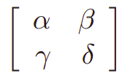
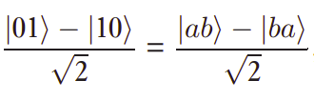
Anti-correlations in the EPR experiment
To see why this is true, suppose |a> and |b> are the eigenstates of Then there exist complex numbers α, β, γ, δ such that
|0> = α|a> + β|b>
|1> = γ|a> + δ|b>
Substituting we obtain |01>−|10> /√ 2 = (αδ − βγ) |ab>−|ba> /√ 2 .
But αδ − βγ is the determinant of the unitary matrix , and thus is equal to a phase factor e^iθ for some real θ. Thus
As a result, if a measurement of performed on both qubits, then we can see that a result of +1 (−1) on the first qubit implies a result of −1 (+1) on the second qubit.

Slide 7
Entanglement
The measurement performed by Alice appears to affect the state of Bob’s particle, but this wording is misleading.
Following special relativity, it is incorrect to think of one measurement happening first and causing the results of the other; it is possible to set up the EPR scenario so that one observer sees Alice measure first, then Bob, while another observer sees Bob measure first, then Alice.
According to relativity, physics must explain equally well the observations of both observers.

Slide 8
Hidden state and local hidden variable
Quantum mechanics is not the only theory that can explain these results; they could also be explained by a classical theory that postulates that particles have an internal hidden state
The hidden state determines the result of the measurement, and that this hidden state is identical in two particles generated at the same time by the EPR source, but varies randomly over time as the pairs are generated.
According to such a classical theory, the reason we see random instead of deterministic results is simply because we, as of yet, have no way of accessing these hidden states.
The hope of proponents of such theories was that eventually physics would advance to a stage in which this hidden state would be known to us. Such theories are known as local hidden-variable theories.

Slide 9
Local hidden variable
Is it possible to construct a local hidden-variable theory that agrees with all of the experimental results we use quantum mechanics to model?
Bell showed that any local hidden variable theory predicts results that satisfy an inequality, known as Bell’s inequality.

Slide 10
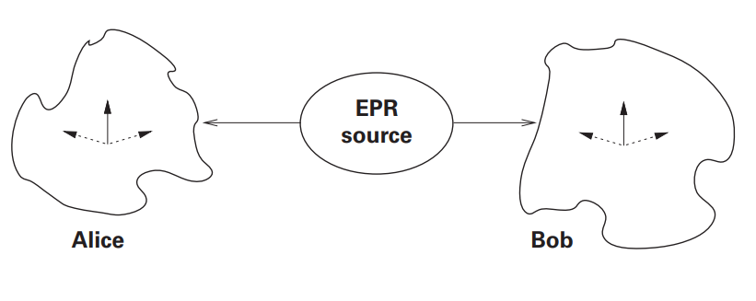
Setup for Bell’s Theorem
Imagine an EPR source that emits pairs of photons whose polarizations are in an entangled state |ψ >= 1/ √ 2 (|↑↑> + |→→>), where we are using the notation |↑> and |→> for photon polarization.
These polaroids can be set at three different angles. In the special case we consider first, the polaroids can be set to vertical, +60◦ off vertical, and −60◦ off vertical.

Slide 11

Set up for Bell’s theorem
The three different settings for each polaroid, −60◦, vertical, and +60◦, correspond to three observables.
The probablity of outcome will be cos² (θ₁ − θ₂) with eigen value 1, we can compute the probability that measurement of two photons, by polaroids set at angles θ₁ and θ₂.
If both polaroids are set at the same angle, then both photon measurements give the same results with probability cos² 0= 1: both photons will pass through the polaroids, or both will be absorbed.

Slide 12




Bell’s inequality
A deterministic hidden variable theory is local if
We have:
The meaning of this is that once the state is specified and the particles have separated, measurements of A can depend on and but not
The more general setup also has a sequence of EPR pairs emanating from a photon source toward two polaroids, with three possible settings.
We now consider polaroids that can be set at any triple of three distinct angles a, b, and c.

Slide 13
Bell’s inequality proof
If we record the results of repeated measurements at random settings of the polaroids, chosen from the settings above, we can count the number of times that the measurements match for any pair of settings.
Let Pxy denote the sum of the observed probability that either
• the two photons interact in the same way with both polaroids (either both pass through, or both are absorbed) when the first polaroid is set at angle x and the second at angle y, or
• the two photons interact in the same way with both polaroids when the first polaroid is set at angle y and the second at angle x.

Slide 14
Bell’s inequality proof
Since whenever the two polaroids are on the same setting, the measurement of the photons will always give the same result P_{xx}= 1 for any setting x.
We now show that the inequality,
P_{ab} + P_{ac} + P_{bc} ≥ 1, known as Bell’s inequality, holds for any local hidden-variable theory and any sequence of settings for each of the polaroids.
The polaroids, when set at the same angle, always give the same result when measuring the photons in an EPR state |ψ> means that both photons of the entangled pair must be in the same equivalence class of hidden states h.

Slide 15

Bell’s inequality proof
Let P^{h}_{xy} be 1 if the result of the two measurements agree on states with hidden variable h, and 0 otherwise.
Since any measurement has only two possible results, simple logic tells us that the result of measuring a photon, with a given hidden state h, in each of the three polaroid settings, a, b, and c, will be the same for at least one of the settings.
Thus, since the two photons of state |ψ >are in the same hidden state, for any h,

Slide 16

Bell’s inequality proof
Let w_{h} be the probability with which the source emits photons of kind h. Then the sum of the observed probabilities Pab + Pac + Pbc is a weighted sum, with weights wh, of the results for photons of each hidden kind h:
The weighted average of numbers all greater than 1 is greater than 1, so since for any h, we may conclude that P_{ab} + P_{ac} + P_{bc} ≥ 1, This inequality holds for any local hidden-variable theory and gives us a testable requirement.

Slide 17
Entanglement and quantum entanglement

Slide 18
Quantum entanglement
To demonstrate quantum entanglement, we will define the controlled-NOT (CNOT) gate and the composition of two systems.
As a result, we define the tensor product between operations q_{o} and q₁ by .

Slide 19
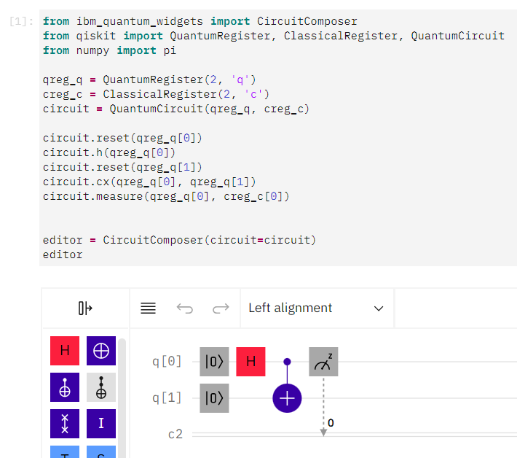
Bell state + z-measurement on qubit 0

Slide 20
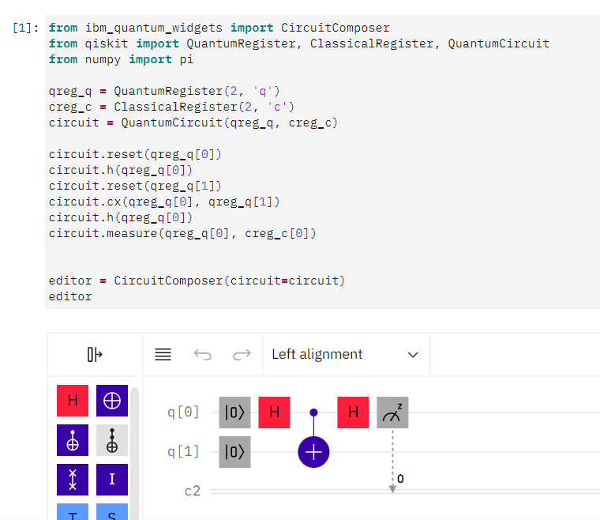
Bell state + x-measurement on qubit 0

Slide 21
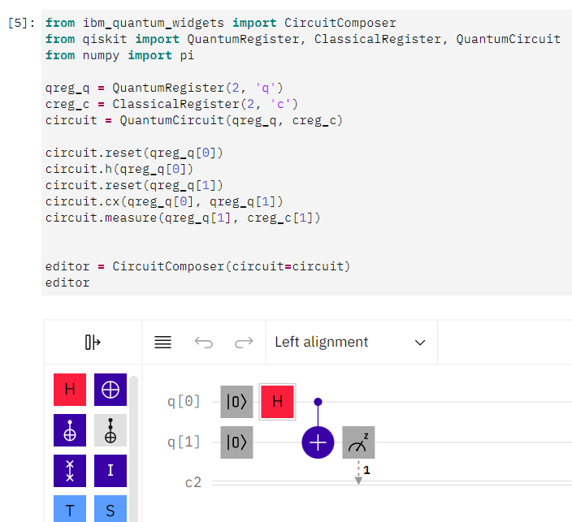
Bell state + z-measurement on qubit 1

Slide 22
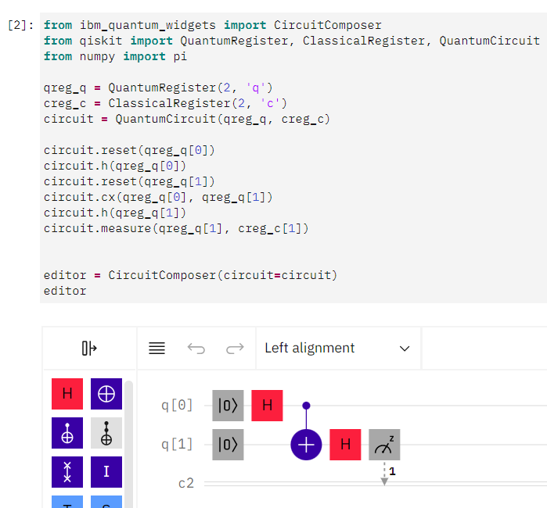
Bell state + x-measurement on qubit 1

Slide 23
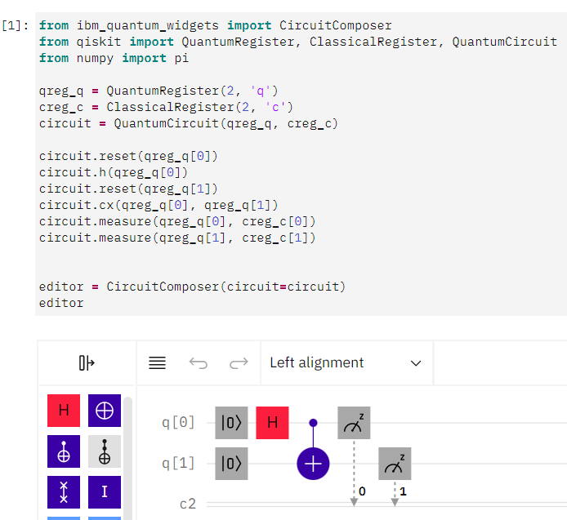
Bell state + zz-measurement on qubits

Slide 24
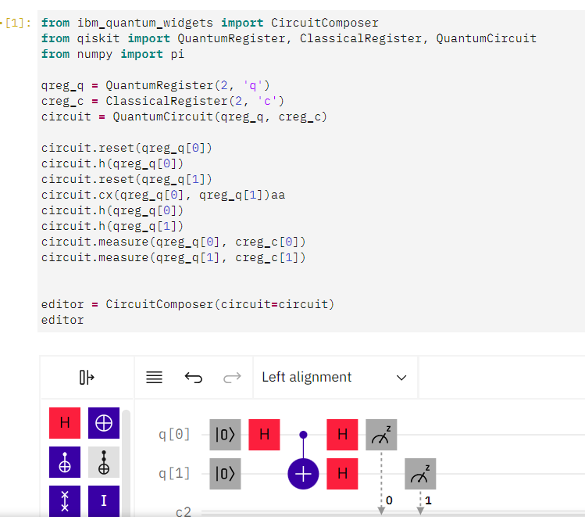
Bell state + xx-measurement on qubits

Slide 25
Reference
Rieffel, Eleanor G., and Wolfgang H. Polak. Quantum computing: A gentle introduction. MIT Press, 2011.
Nielsen, Michael A., and Isaac Chuang. "Quantum computation and quantum information." (2002): 558-559.
https://quantum-computing.ibm.com/composer/docs/iqx/guide/entanglement
https://www.digimat.in/nptel/courses/video/115101092/L38.html

